Slide 1
Concepts to be covered (not to be included in the presentation)
Wheel of science / empirical cycle
Research question
Empirical
Induction
Deduction
Phases: Theory, Data collection etc…

Slide 2
The Empirical cycle
Henk van der Kolk

Slide 3
Aim
Introducting the idea of ‘doing research’
Showing activities that together are called ‘empirical research’

Slide 4
Example: the cause of cholera

Slide 5
What is emperical research
Empirical research: systematically answering empirical questions.
Systematically: excluding the possibility that other answers are better than the answer we give.
Empirical: about things we can observe.

Slide 6
Procedure
Throwing dices or animal bones?
Listening to your parents?
Asking experts?
Clear thinking?
Thinking & observing?
Empirical research question
Knowledge/answer

Slide 7
PRocedure
Thinking
Planning
Observing
Analyzing

Slide 8
Procedure
Maybe I missed my statistics exam, because I did not study hard enough
Compare all exams I did; see how much I worked and which grade I got
I use my electronic calender and the grade centre to check that
Wow, yes, only when I studied hard I passed the exam!

Slide 9
Procedure
Theory
Research design
Data collection
Data analysis

Slide 10
Question
Theory
Data collection
Data analysis
Answers/ knowledge
Research design

Slide 11
Induction
Deduction
Question
Theory
Data collection
Data analysis
Answers/ knowledge
Research design

Slide 12
Wheel of science
Not a logistical sequence of steps: anything goes...
A way to defend conclusions; logic.

Slide 13
Example
RQ: “What causes cholera?”
Dominant idea (agreement reality) around 1850:
“miasma theory”;
diseases like cholera are caused by pollution or “bad air”

Slide 15
Question
Theory
Data collection
Data analysis
Answers/ knowledge
Research design
Notes:
Animatie op het te behandelen onderdeel?

Slide 16
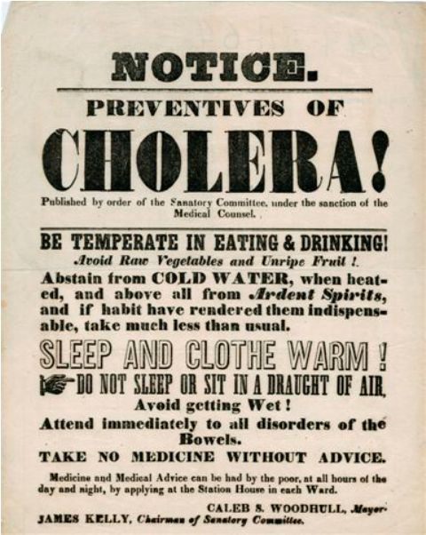
theory
“Drinking fouled water causes cholera”

Slide 17
Question
Theory
Data collection
Data analysis
Answers/ knowledge
Research design

Slide 18
Research design
Dr. Snow decided to compare households that used different waterpumps, including the much-frequented street-pump in Broad Street.

Slide 19
Question
Theory
Data collection
Data analysis
Answers/ knowledge
Research design

Slide 20
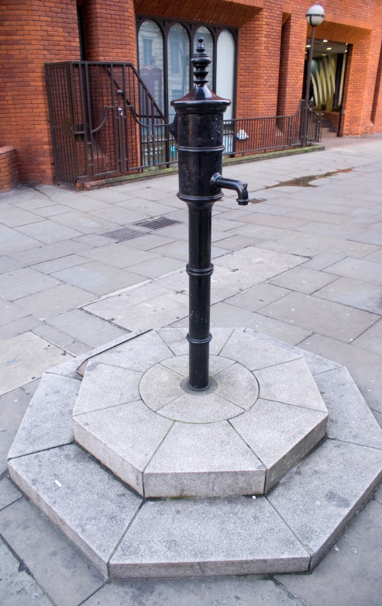
Data collection & data analysis
Dr. Snow tracked down information from hospital records on when the outbreak began and whether the victims drank water from the Broad Street pump.
Notes:
Plaatje pomp nogmaals opzoeken

Slide 21
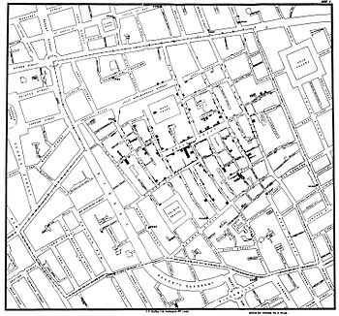
He used a geographical grid to chart deaths from the outbreak.

Slide 22
Question
Theory
Data collection
Data analysis
Answers/ knowledge
Research design

Slide 23
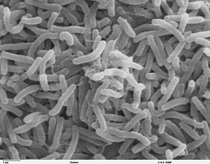
Answer
Cholera is caused by fouled water

Slide 24
Wheel of science
Not a logistical sequence of steps: anything goes...
It is a way to defend conclusions: logic.

Slide 25
This microlecture
Introduced you to the basic idea of doing research
Described a series of activities that are called ‘empirical research’

Slide 27
Images used
Slide 3: http://upload.wikimedia.org/wikipedia/commons/c/c4/Africa_cholera2008b.jpg
Slide 14: http://commons.wikimedia.org/wiki/File:John_Snow.jpg#/media/File:John_Snow.jpg
Slide 16: http://upload.wikimedia.org/wikipedia/commons/d/d3/Cholera_Epidemic_poster_New_York_City.jpg
Slide 20: https://www.flickr.com/photos/adambowie/345845299
Slide 21: https://commons.wikimedia.org/wiki/File:Snow-cholera-map-1.jpg
Slide 23: https://en.wikipedia.org/?title=Cholera#/media/File:Cholera_bacteria_SEM.jpg

