Slide 1
CONceptualization: constructs as combinations of facets and terms

Slide 2
AIM
Conceptualization
Concept (a.k.a. ‘term’) and its ‘facets’
Four types of relationships between terms & facets:
And: Necessary & Sufficient conditions (‘(not) being a bachelor’)
Not: Typologies (‘type of welfare state’)
Or: Family resemblance (‘being sick’)
Missing: A set of similar variables (‘personality’)

Slide 3
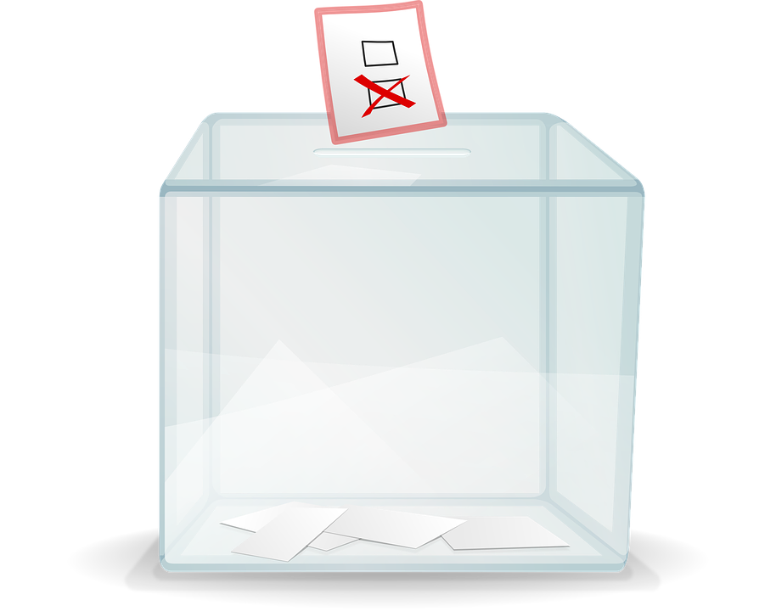
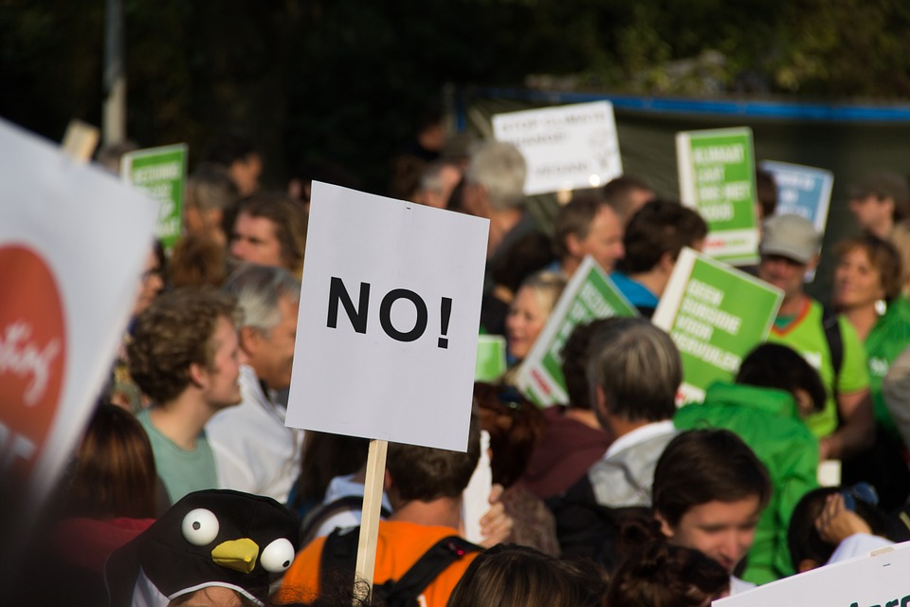
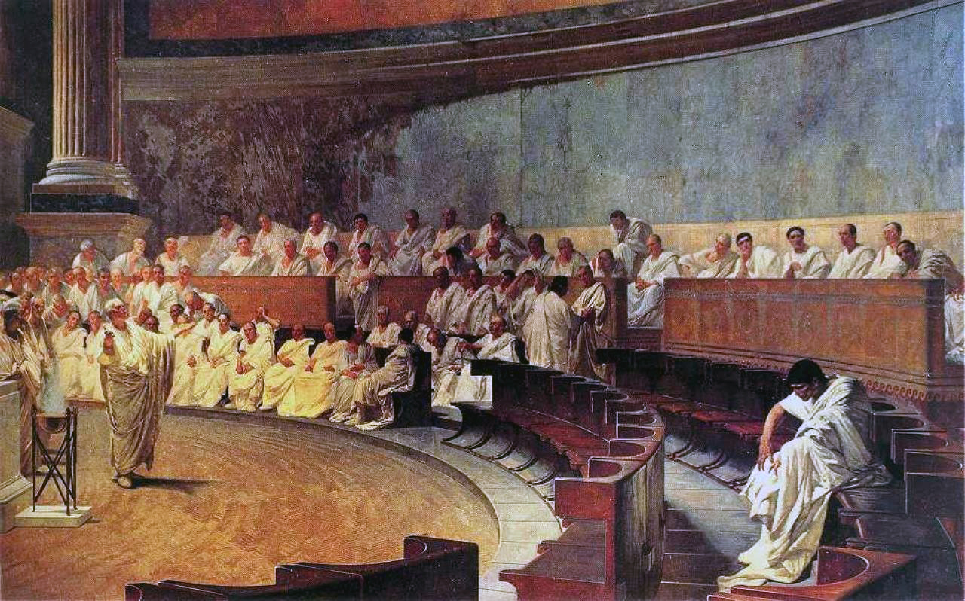
EXAMPLE: CONCEPTUALIZING DEMOCRACY

Slide 4
EVERYONE USES ‘CONCEPTS’
“In the 21st century, most states are democratic”
Setting (temporal)
Units
Variable
Concepts like 21st century / ‘states’ / ‘democratic’ are social constructions

Slide 5
EXAMPLES OF CONCEPTS
Violence
Ethnocentrism
Intelligence
Bachelor
Democracy
Here, we focus on concepts that are theoretical variables

Slide 6
RELATING ‘CONCEPTS’ TO ‘OBSERVATIONS’
Conceptualization
Operationalization
Measurement
Concept/term
Facets
Indicators
Observations
inductive
deductive

Slide 7
CONCEPTS
Many theoretical variables seem to be simple:
Gender
The amount of money on a bank account
The amount of energy produced by a windmill
These are ‘concepts’, but seldom called ‘constructs’

Slide 8
EXAMPLE OF A ‘CONSTRUCT’
Bachelor (as in ‘bachelor party’)
Bachelor is a variable characterizing people:
people are or are not bachelors.
Notes:
What is a ‘bachelor’?

Slide 9
EXAMPLE 1: BEING A BACHELOR
Facets
“Married or not”
Construct/Concept/Term
“Being a bachelor
or not”
“Over 18 or not”
“Male or not”

Slide 10
‘CONSTRUCTS’ CONSIST OF ‘FACETS’
Facets
Variable
Variable
Construct/Concept/Term
Variable
Variable
Variable
Variable
Variable

Slide 11
RELATIONSHIPS BETWEEN FACETS AND TERMS
How are ‘facets’ related to ‘terms’?

Slide 12
EXAMPLE: BEING A BACHELOR
“Married or not”
and
“Being a bachelor
or not”
and
“Over 18 or not”
and
“Male or not”

Slide 13
RELATIONSHIPS BETWEEN FACETS AND TERMS
And: necessary and sufficient conditions

Slide 14
NECESSARY AND SUFFICIENT CONDITIONS
If we miss information about one of the facets, we cannot tell … (all facets are necessary)
If we have information about the three facets, we can tell … (the set of facets is sufficient)

Slide 15
EXAMPLE 2: GENDER AS DICHOTOMY
and
“has male or female biological characteristics”
Gender
Biologically man
Biologically woman
Is male or female?
Socially man
Socially woman
Man
Woman
and
“presents socially as male or female?”
Notes:
So, the factes were clearly related

Slide 16
EXAMPLE 2: GENDER AS NORMAL VARIABLE ‘TYPOLOGY’
Biologically man
not
“presents socially as male or female?”
Man
Transgender
Socially man
Socially woman
not
Transgender
Woman
“has male or female biological characteristics”
Biologically woman

Slide 17
RELATIONSHIPS BETWEEN FACETS AND TERMS
And: necessary and sufficient conditions
Not: creating (matrix) typologies
Notes:
UITLEG NOT is wellicht te moeilijk … PJ begrijpt het niet …

Slide 18
EXAMPLE 3: DEMOCRACY
What may be the underlying facets of democracy?
Rule of law
Popular elections

Slide 19
‘CONSTRUCTS’ CONSIST OF ‘FACETS’
Dimensions/facets
rule of law
Construct/Concept/term
democracy
popular elections

Slide 20
TWO ‘DIMENSIONS’ DEFINING DEMOCRACY USING ‘AND’
Right to participate
(political freedom)
No democracy
Democracy
No liberties
(no rule of law)
Liberties
(rule of law)
No democracy
No democracy
No right to participate
(no political freedom)

Slide 21
TWO ‘DIMENSIONS’ DEFINING REGIME TYPES USING ‘NOT’
Right to participate
(political freedom)
Electoral dictatorships
Democracy
No liberties
(no rule of law)
Liberties
(rule of law)
Autocracy
Liberal autocracies
No right to participate
(no political freedom)

Slide 22
RELATIONSHIPS BETWEEN FACETS AND TERMS
And: necessary and sufficient conditions
Not: creating (matrix) typologies
Or: family resemblance (sufficient conditions)

Slide 23
TWO ‘DIMENSIONS’ DEFINING DEMOCRACY USING ‘OR’
Right to participate
(political freedom)
Democracy
Democracy
No liberties
(no rule of law)
Liberties
(rule of law)
No democracy
Democracy
No right to participate
(no political freedom)
Notes:
Ander voorbeeld Athleet
Twee facetten: hard kunnen lopen, sterk zijn
Ben je een all-rounder …
Productiveness: hard werken … skills ….. (is oorzaak??)

Slide 24
RELATIONSHIPS BETWEEN FACETS AND TERMS
And: necessary and sufficient conditions
Not: creating (matrix) typologies
Or: family resemblance (sufficient conditions)
Missing: just a set of ‘somehow related variables’
Notes:
In this context, democracy is just a set of words to describe … we will not say a country is or is not democratic
Similar to the word personality. You do not say person has or has no personality. The word refers to a set of words …

Slide 25
THIS MICROLECTURE
Conceptualization
Concept (a.k.a. ‘term’) and its ‘facets’
Four different ways of relating facets and terms
Not: Creating typologies
And: Necessary and Sufficient conditions
Or: Family resemblance relationships
Missing: Just a set of somehow related variables

