Slide 1
CONceptualizing: intensions and extension of constructs

Slide 2
AIM
Intension and extension of constructs
Two (of four) relationships between constructs and facets:
Necessary and Sufficient
Family resemblance (sufficiency)

Slide 3
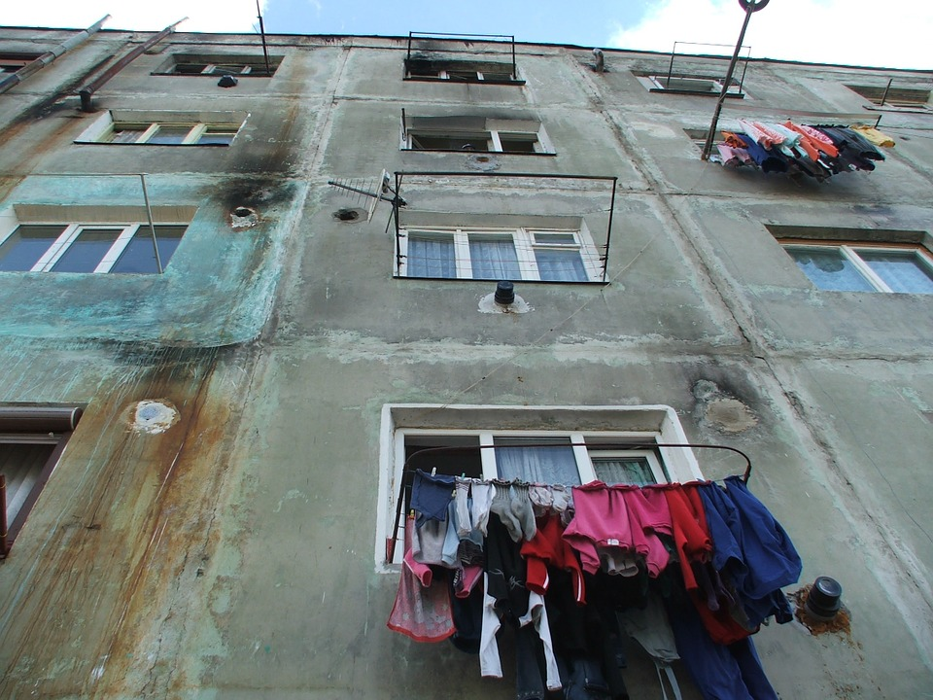
EXAMPLE: CONCEPTUALIZING A ‘POOR NEIGHBORHOOD’
Dichotomous variable ‘(not a) poor neighborhood’

Slide 4
‘CONSTRUCTS’ CONSIST OF ‘FACETS’
Facets
variable
Construct/Concept/Term
variable
variable

Slide 5
EXAMPLE: POVERTY OF NEIGHBORHOODS
Facets
Average income of inhabitants
Construct/Concept/Term
Average education level of inhabitants
Poor neighborhood or not
Quality of houses

Slide 6
RELATING FACETS AND TERMS
Four types of relationships:
(Missing: a set of related concepts)
(Not: creating (matrix) typologies)
And: necessary and sufficient conditions
Or: family resemblance

Slide 7
EXAMPLE: POVERTY OF NEIGHBORHOODS
Facets
Average income of inhabitants
and
Lowest 10% or not
Construct/Concept/Term
Average education level of inhabitants
Poor neighborhood or not
Over 20% only basic level of education (or not)
and
and
At least 20% should be renovated (or not)
Quality of houses
Notes:
De grenswaarde bepaalt ook de intensie van het begrip, … dus naar 20% doet ook de extensie stijgen ….

Slide 8
EXAMPLE: POVERTY OF NEIGHBORHOODS
Facets
Average income of inhabitants
or
Lowest 10% or not
Construct/Concept/Term
Average education level of inhabitants
Poor neighborhood or not
Over 20% only basic level of education (or not)
or
or
At least 20% should be renovated (or not)
Quality of houses
Notes:
De grenswaarde bepaalt ook de intensie van het begrip, … dus naar 20% doet ook de extensie stijgen ….

Slide 9
INTENSION AND EXTENSION
Intension: number & characteristics of facets of a term
Extension: number of units to which a term applies

Slide 10
EXAMPLE: POVERTY OF NEIGHBORHOODS
Facets
Average income of inhabitants
and
Lowest 10% or not
Construct/Concept/Term
Average education level of inhabitants
Poor neighborhood or not
Over 20% only basic level of education (or not)
and
and
At least 20% should be renovated (or not)
Quality of houses
Notes:
De grenswaarde bepaalt ook de intensie van het begrip, … dus naar 20% doet ook de extensie stijgen ….

Slide 11
EXAMPLE: POVERTY OF NEIGHBORHOODS
Number of poor neighborhoods
based on income only
Number of poor neighborhoods
based on income and education
(Number of units)
Number of poor neighborhoods
based on income, education and quality of houses
= “Extension”
1
2
3
Number of facets
= “Intension”
Notes:
Leuk idee van PJ: kun je ook met Venn-diagrammen doen!

Slide 12
INTENSION AND EXTENSION
IF necessary and sufficient relationships are assumed (= AND) …
Intension increases (the number of facets increases)
Extension (number of units it applies to) decreases

Slide 13
FAMILY RESEMBLANCE
‘Or’ relationship (family resemblance)
Units can be different with respect to the facets they have, but they also ‘share’ something.

Slide 14
POVERTY OF NEIGHBORHOODS
Facets
Average income of inhabitants
or
Construct/Concept/Term
Average education level of inhabitants
Poor neighborhood or not
or
or
Quality of houses

Slide 15
INTENSION AND EXTENSION
Number of poor neighborhoods
based on income
Concepts defined using
family resemblance
Number of poor neighborhoods
based on income, or education or housing quality
(Number of units)
= “Extension”
Number of poor neighborhoods
based on income or education
1
2
3
Number of facets
= “Intension”

Slide 16
THIS MICROLECTURE
Necessary and Sufficient relationships
Family resemblance
Intension and extension of concepts

