Slide 1
Concepts to be included
Reliability
Random error
Test-retest method
Cronbach’s alpha
(Measurement) Validity (and its reverse: data collection bias)
Construct validity
Content validity
Criterion-related validity
(Face validity)
(test-)reactivity (also in the context of experiments: Solomon four group design)
Triangulation
Data matrix
Codebook

Slide 2
Reliability and Validity in Measurement
Henk van der Kolk

Slide 3
Aim
Understanding mistakes in measurement:
(un)Reliability
Validity (bias)
Some methods to assess reliability
Some methods to assess validity

Slide 4
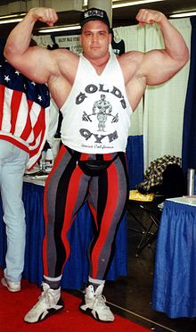
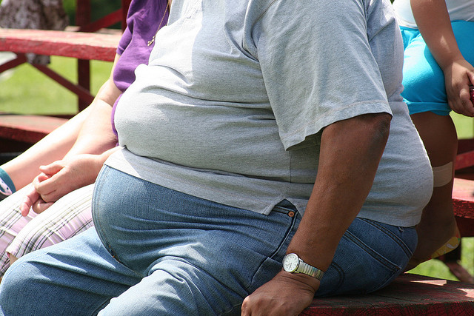
Example
Weight and obesitas

Slide 5
Two aspects of observation
Example:
‘How many people in the EU are obese?’
Theoretical variable(s)
Conceptualization
Operationalization
Measurement
Sampling
Unit (s)
Data

Slide 6
Two aspects of observation
Example:
‘How many people in the EU are obese?’
Theoretical variable(s)
Sampling
Unit (s)
Data

Slide 7
Assessing operationalisation & measurement
Even when we observe the right set of units, observation may be imperfect: we make mistakes.
Two types of observation mistakes:
Random errors
Systematic errors (systematic bias or measuring the wrong construct)

Slide 8
Assessing operationalisation & measurement
Measurement reliability: the absence of random error.
Measurement validity: no systematic error, (on average) measure what you intend to measure.

Slide 9
Example
Operationalize ‘weight’ using a scale
Every individual steps on the scale 10 times
Use three different scales (= three operationalizations)
Assess the operationalizations using the criteria of validity and reliability

Slide 10
Scale 1: not reliable
Number of
observations
Weight

Slide 11
Scale 2: somewhat reliable
Number of
observations
Weight

Slide 12
Scale 3: very reliable
Number of
observations
Weight

Slide 13
Measurement Validity
The operationalization may be ‘reliable’ ….
Is it also correct (valid, unbiased)?

Slide 14
Very reliable, but not valid
Number of
observations
‘True’ Weight
Weight

Slide 15
Reliable, and valid
Number of
observations
‘True’ Weight
Weight

Slide 16
Assessing measurement validity
Validity of an operationalization cannot be not observed directly, because the ‘true’ value is unknown …
Three approaches to measurement validity:
Content validity
Criterion validity
Construct validity

Slide 17
Content validity
Does it cover all aspects of the concept?’
Examples:
Obesitas as measured by BMI (based on weight and length)
Measuring the concept ‘mathematical ability’

Slide 18
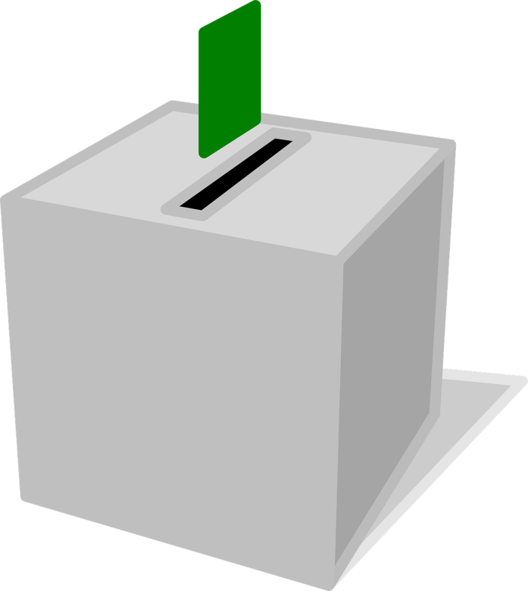
Criterion validity
Is it ‘correctly’ related to conceptually related indicators?’
Example:
‘did you vote in the last general election’
checked by using the actual voting records?

Slide 19
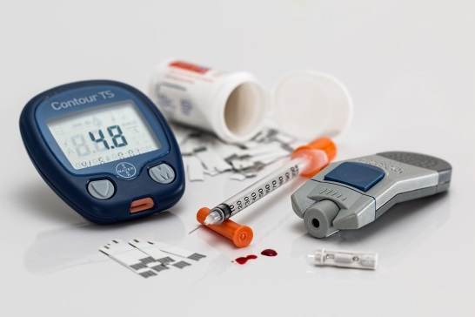
Construct validity
Is it ‘correctly’ related to other theoretically related variables?’
Assessing different operationalizations of ‘Obesitas’:
BMI, Body Adiposity Index; Waist Circumference Measurement; Waist-to-Hip Ratio; Hydrostatic Weighing; Body Fat Measuring
How are they related to health problems?

Slide 20
Weighing measurement validity and reliability
Operationalization is used four times;
Which do you prefer?
variable
variable
(1)
(2)

Slide 21
This microlecture
Measurement errors
(un)reliability
Validity (bias)
Some methods to assess reliability
Some methods to assess validity

Slide 23
Images used
Slide 4: https://www.flickr.com/photos/78428166@N00/3872155588
Slide 4: https://www.flickr.com/photos/elidoturco/6803524257
Slide 4: https://en.wikipedia.org/wiki/Greg_Kovacs
Slide 9: https://pixabay.com/en/scale-diet-fat-health-tape-weight-403585/
Slide 18: https://pixabay.com/en/ballot-vote-box-voting-296577/
Slide 20: https://pixabay.com/en/diabetes-blood-sugar-diabetic-528678/

