Slide 1
Concepts to be included
Operationalization
Indicator
Measurement
(in)direct observable
Construct
Content validity
Triangulation
Data matrix

Slide 2
Operationalization and Measurement
Henk van der Kolk

Slide 3
Aim
Measuring a ‘theoretical concept’
Observables and constructs
Conceptualization, operationalization, measurement
Content validity of an operationalization
Storing data in a data matrix

Slide 4
Example of a theoretical construct: IQ

Slide 5
Two aspects of observation
Example:
‘What is the IQ of students at this university?’
Theoretical variable(s)
Conceptualization
Operationalization
Measurement
Sampling
Unit (s)
Data

Slide 6
Two aspects of observation
Theoretical variable(s)
Conceptualization
Operationalization
Measurement
Data

Slide 7
Observables and constructs
Some ‘theoretical concepts’ or ‘theoretical variables’ are relatively simple: (direct or indirect) observables
Example: gender, age …
Other ‘theoretical concepts’ are complex, consisting of various dimensions or aspects: constructs
Example: bachelor, democracy, centralization, IQ …

Slide 8
Conceptualization (Def.)
Making clear what you mean with the theoretical construct, its possible dimensions or aspects, and its attributes (values)

Slide 9
Example
An intelligence quotient (IQ) is a score derived from a test. The median raw score of a ‘norming sample’ is defined as IQ 100. Each standard deviation up or down is defined as 15 IQ points greater or less.
Therefore, approx. two-thirds of the population scores between IQ 85 and IQ 115. About 5 percent of the population scores above 125.

Slide 10
Operationalization (Def.)
The construction of the exact procedures, to be used for data collection, in the context of some data collection method.
Example:
Formulating questions or items measuring intelligence.

Slide 11
Examples of iq tests
The same theoretical concept or variable can be operationalized in many ways: there is no single correct operationalization:
Wechsler Adult Intelligence Scale
Stanford-Binet
Woodcock-Johnson Tests of Cognitive Abilities
Kaufman Assessment Battery for Children
Cognitive Assessment System
Differential Ability Scales

Slide 12
Sources of operationalizations
Existing measurement instruments in
Articles and books about the topic
Books with operationalizations (scales, indices)
Thinking, creativity

Slide 13
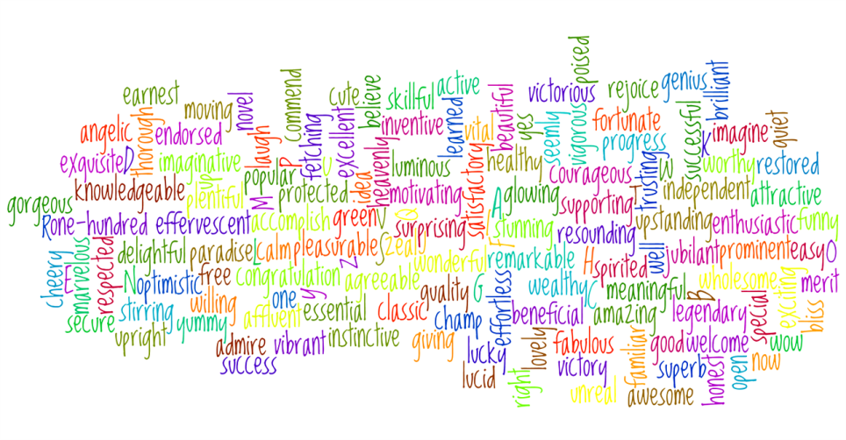
Indicator
Operationalization of constructs consist of a set of indicators.
Example:
one of the sub-tests of the WAIS IQ scale is based on finding similarities between words. This is an operationalization of “Abstract verbal reasoning”

Slide 14
Content validity
If all aspects of a construct are included in the operationalization, it is said to have ‘content validity’.
This is an aspect of ‘measurement validity’.
Examples:
IQ (“Abstract verbal reasoning” and many other aspects)
Democracy
Mathematical abilities

Slide 15
Triangulation (def.)
Using at least two different operationalizations (often in the context of different data collection methods) to measure the same theoretical concept for the same units
Notes:
Plaatje voldoet niet helemaal:
** voeg in: Picture, measuring an objects from two sides.

Slide 16
Measurement (DEF.)
Following a specified procedure (in the context of some data collection method) in order to get ‘observations’, ‘data’.

Slide 17
Storing data in a data matrix
Direct observable in a survey: gender
Indirect observable in a survey: age

Slide 18
Data matrix
 | Gender | Year born | Var | ...
1 | Observation | ... | ... | ...
2 | ... | ... | ... | ...
3 | ... | ... | ... | ...
4
Unit 5 | Man | 1965
...
N | ... | ... | ... | ...

Slide 19
Storing data of a construct
Many indicators for several aspects of IQ

Slide 20
Storing data of a construct
 | ID | Item 1 | Item 2 | Item 3 | Item 4 | Verbal reasoning
1 | 1 | 1 | 1 | 1 | 1 | 4
2 | 2 | 0 | 1 | 0 | 1 | 2
3 | 3 | 1 | 1 | 0 | 1 | 3
4 | 4 | 0 | 0 | 1 | 0 | 1
5 | 5 | 1 | 1 | 1 | 1 | 4
...
N | ... | ... | ... | ... | ... | ...

Slide 21
This microlecture
Measuring theoretical constructs
Three topics:
Conceptualization, operationalization, measurement
Content validity of an operationalization (which is an aspect of measurement validity)
Storing data in a data matrix

Slide 23
Images used
Slide 4: https://pixabay.com/en/brain-turn-on-education-read-book-770044/
Slide 12: https://pixabay.com/en/measure-scale-double-m-accuracy-629659/
Slide 13: https://pixabay.com/en/words-alphabet-word-cloud-639303/
Slide 14: https://pixabay.com/en/math-number-school-symbol-611503/
Slide 15: http://pad2.whstatic.com/images/thumb/a/a4/Calculate-Square-Meters-Step-2-Version-2.jpg/670px-Calculate-Square-Meters-Step-2-Version-2.jpg
Slide 17: https://pixabay.com/en/gender-sex-symbol-male-female-312411/

