Slide 1
The effect of third variables: confounding
Henk van der Kolk

Slide 2
Aim
Understanding the potential effect of ‘third’ variables, more specifically “Explanation/Confounding”

Slide 3
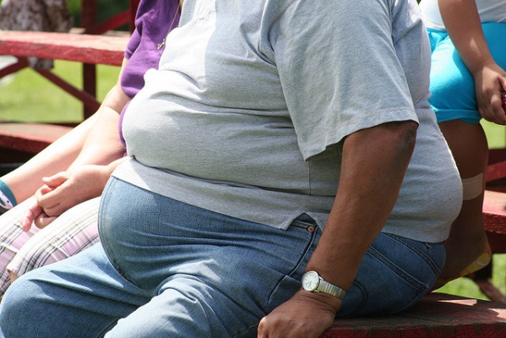
example
Relationship between # of storks and # of babies (per capita) in municipalities
Relationship between Social Class
and Obesity of individuals

Slide 4
The bivariate expectation in a model
Number of storks
Number of babies

Slide 5
The expectation in a graph
Babies
Storks

Slide 6
Testing the causal relationship
(correct time order is assumed)
(we found an association)
What would be the ‘theoretical argumentation’ about why this is still NOT a causal relationship?

Slide 7
Confounding in a model
Degree of urbanization
Number of storks
Number of babies

Slide 8
Confounding in a model
Degree of urbanization
Number of storks
Number of babies

Slide 9
Confounding in a graph
Not urbanized (1)
Babies
Urbanized (3, low)
Urbanized (5, medium)
Urbanized (7, high)
Urbanized (10, highest)
Storks

Slide 10
Confounding in a model
Confounder
Independent variable
Dependent variable

Slide 11
example
Relationship between Social Class and Obesity of individuals, maybe because of ‘ability to plan’

Slide 12
Confounding in a model
Ability to plan
Social class
Obesity

Slide 13
Confounding in a graph
Ability to plan (1)
Obesity
AtP (3, low)
AtP (5, medium)
AtP (7, high)
Ability to plan (10, highest)
Social class

