Slide 1
Testing trivariate hypotheses Using trivariate tables
Henk van der Kolk

Slide 2
Aim
Testing a bivariate hypothesis means studying
Time order
Correlation/association
Non-spuriousness
Theorizing potential confounders
Formulating a trivariate hypothesis
Testing the trivariate hypothesis
Constructing a trivariate table

Slide 3
example
Using ‘confounding’ to show the idea of ‘elaboration’ and ‘trivariate tables’, … but …
… it also applies to: interpretation, modification, addition etc…

Slide 4
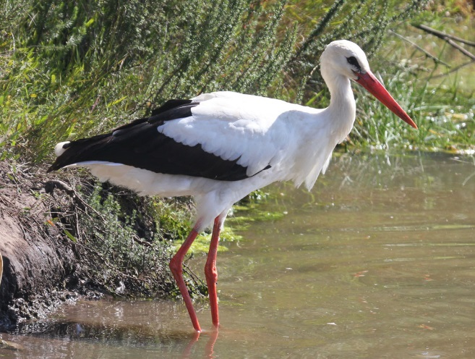
example
Relationship between # of storks and # of babies (per capita) in municipalities

Slide 5
Title
Table: Y by X (absolute numbers; column percentages)(N=...)
Independent variable
X
Increasing order of values
Low
High
Total
Column percentages
Negative
Dependent
variable
Y
Positive
Total

Slide 6
Table: # of babies by # of storks (absolute numbers;
column percentages)(N= 400 (municipalities))
# storks
Low
High
Total
130 (65%) | 70 (35%) | 200
70 (35%) | 130 (65%) | 200
200 (100%) | 200 (100%) | 400
Low
# babies
High
Total

Slide 7
Confounding in a model
Degree of urbanization
Number of storks
Number of babies

Slide 8
Confounding in a graph
Babies
Not urbanized (1) low
Very urbanized (10, highest)
Storks

Slide 9
Table: # of babies by # of storks (absolute numbers;
column percentages)(N= 400 (municipalities))
# storks
Low
High
Total
130 (65%) | 70 (35%) | 200
70 (35%) | 130 (65%) | 200
200 (100%) | 200 (100%) | 400
Low
# babies
High
Total

Slide 10
Table: # of babies by # of storks (absolute numbers;
column percentages)(N= 400 (municipalities))
# storks
Not urbanized
Urbanized
Low
High
Total
(10 + 120 = ) 130 (65%) | (40 + 30 = ) 70 (35%) | 200
(30 + 40 = ) 70 (35%) | (120 + 10 = ) 130 (65%) | 200
200 (100%) | 200 (100%) | 400
Low
# babies
High
Total

Slide 11
Table: # of babies by # of storks (absolute numbers;
column percentages)(N= 400 (municipalities))
Not urbanized
Urbanized
# storks
# storks
Low
High
Total
Low
High
Total
10 (25%) | 40 (25%) | 50
30 (75%) | 120 (75%) | 150
40 (100%) | 160 (100%) | 200
120 (75%) | 30 (75%) | 150
40 (25%) | 10 (25%) | 50
160 (100%) | 40 (100%) | 200
Low
# babies
High
Total

Slide 12
Confounding in a graph
Babies
Not urbanized (1) low
Very urbanized (10, highest)
Storks

Slide 13
Testing trivariate hypotheses Using trivariate tables
Henk van der Kolk

