Slide 1
Data matrix in spss

Slide 2
AIM
A basic introduction to the data matrix in SPSS.

Slide 3
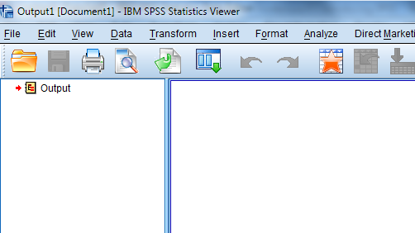
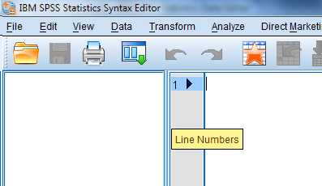
Menu
Data(matrix) (.sav)
or
Output (.spv)
Graph/table
Syntax file (.sps)

Slide 4
Data view/variable view

Slide 5
From question to data matrix
Theoretical variable(s)
Work or not
Person
1
2
3
4
5
6
7
8
9
10
0
1
1
1
1
0
999
0
1
0
Unit(s) / cases
Data
Notes:
Like all research, content analysis starts with a research question …

Slide 6
Labeling variables (codebook)
A codebook describes
the meaning of variables and values used in the data matrix.
Variable name (short): ‘WORK’ or ‘WorkYN’ or ‘V1’
Variable label (clear): meaning of variable (Is respondent working or not?)
Value label: meaning of the value (0 = no work; 1 = work; 999 = no answer)

Slide 7
Labeling variables
Variable name
Variable label
V1 ‘Is respondent working or not?’
0 = no work
1 = work
999 = no answer
Value label
Value

Slide 8
Here a short part showing how that works in SPSS

Slide 9
THIS MICROLECTURE
What a (broad format) datamatrix in SPSS is
How to ‘store’ data in a data matrix
How to read a data matrix, using the ‘codebook’ (labels)

