Slide 1
SPSS
Statistical
Package for the
Social
Sciences

Slide 2
Document.docx

Slide 3
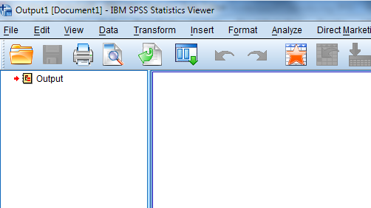
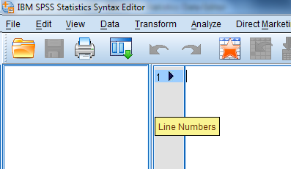
Menu
Data(matrix) (.sav)
or
Output (.spv)
Syntax file (.sps)

