Slide 1
Statistical inference in the context of regression (without formula)

Slide 2
5
7
4
8
Y
1
3
6
Y = 2 + 0,8 X
2
X
R² = 0,4
Notes:
This is a simple scatterplot with two variables: X and Y . The scatterplot has 8 units, people for example, or cities …. (en dan een beetje uitleggen)

Slide 3
Using these 8 data points …
we can calculate
A mean for both X and Y
A standard deviation for both X and Y
An intercept
A regression coefficient (the ‘angle’) and
R-square
These are all aspects of ‘descriptive statistics’.
Notes:
This may confusing, for we introduced regression analysis to study causal questions using cross sectional data and time series data. Why then ‘descriptive’?

Slide 4
Descriptive research questions:
Summarizing basic features of a set of units
Inferential statistics:
Using (sample) data to say
something about a large
population
Descriptive statistics:
Summarizing basic features of
the data we have.
Sample means, b’s, R²
Significance,
Confidence intervals
Causal/explanatory research questions:
Studying the cause and effect relationships within a set of units

Slide 5
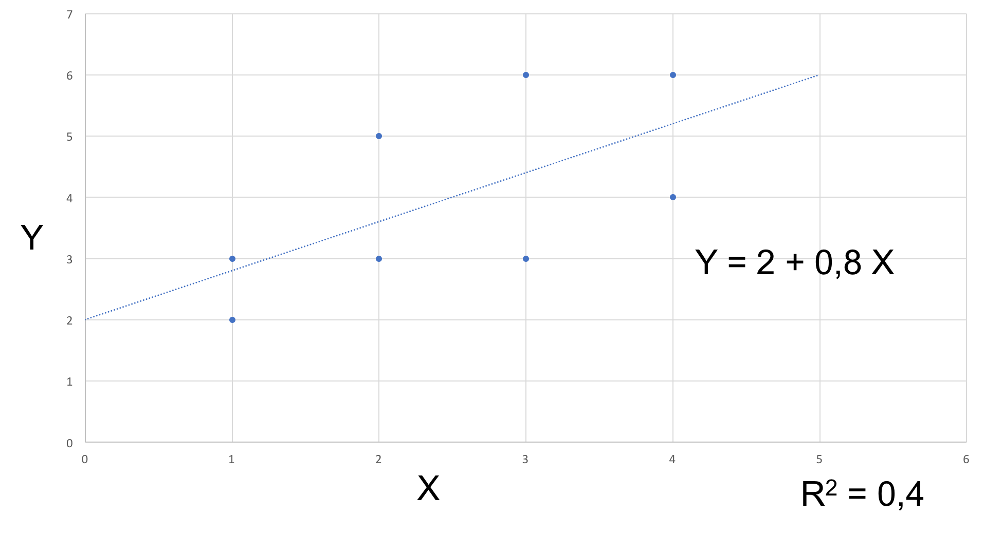
Population
(random)
sample
“Inference”
Notes:
Of course, some people will just take the relationship we find in the sample data (or worse, the selected data we have) to reflect something in the population. We found a positive relationship SO, there is probably a positive relationship in the population …. But how do you know?

Slide 6
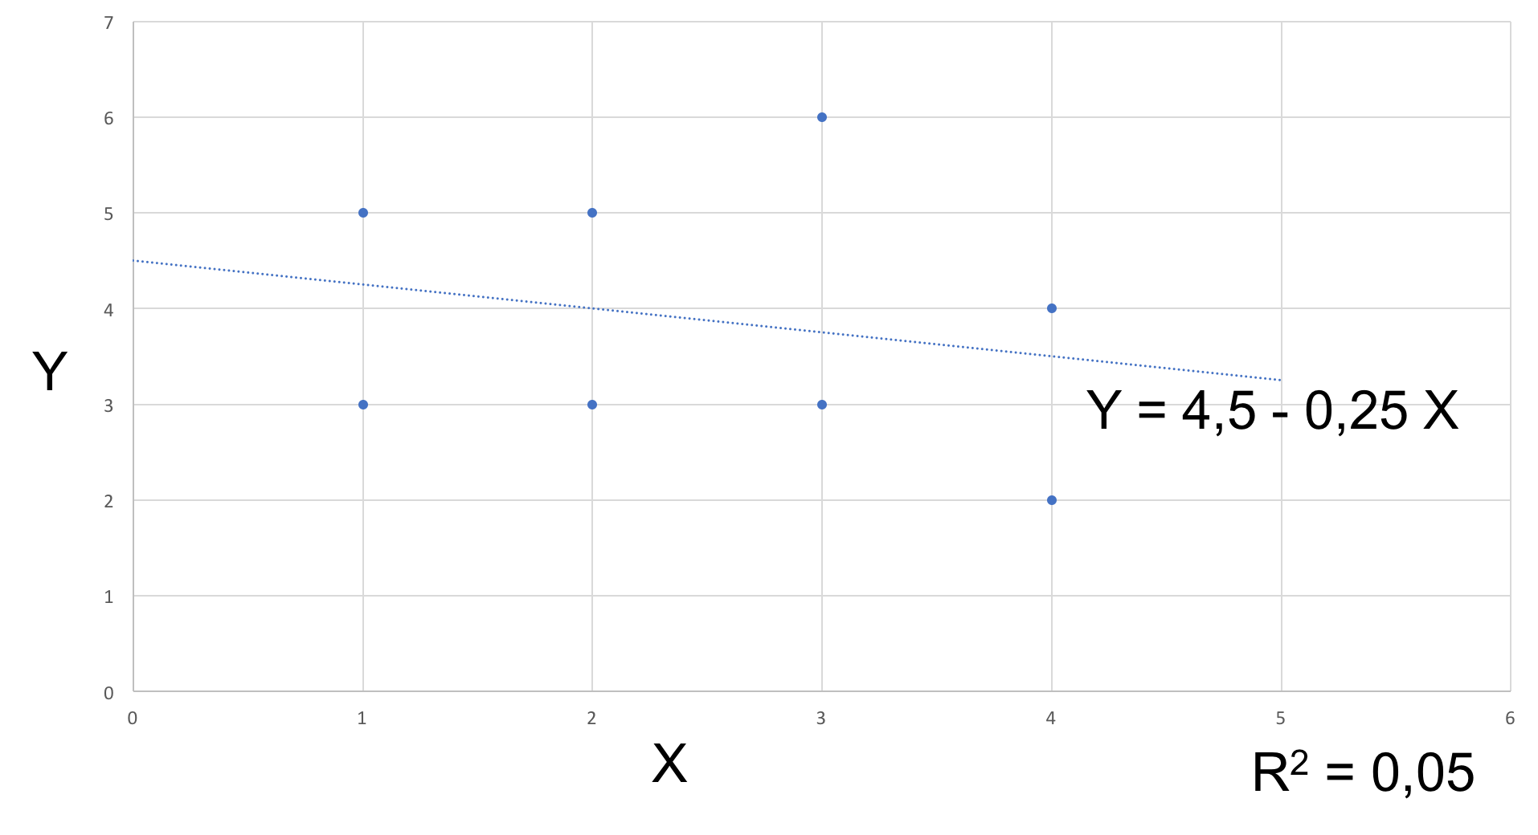
(random)
sample
(random)
sample
???
Notes:
Eerst die tweede even laten zien en dan weer terug naar de eerste. Slechts twee datapunten wijken af ☺

Slide 7
Inference
Inference is thinking about
“what my data say about the population”
In the context of regression it is associated with words like:
“significance”
“P-values”
“confidence intervals”
“Standard ‘error’” (as compared to ‘standard deviation’)
Notes:
M: Hier zou ik al iets concreter worden over inferentie, bijvoorbeeld kort wat je op slide 14 zegt. Zodat de kijker je in de volgende slides kan volgen met een idee van het eindpunt
M: t waarden moeten ook standaard gerapporteerd worden, dus zou ik hier ook noemen

Slide 8
Population
Greek letters: 𝛃, 𝛔, 𝛆
(random)
sample
(random)
sample
???
Latin letters: b, s, e

Slide 9
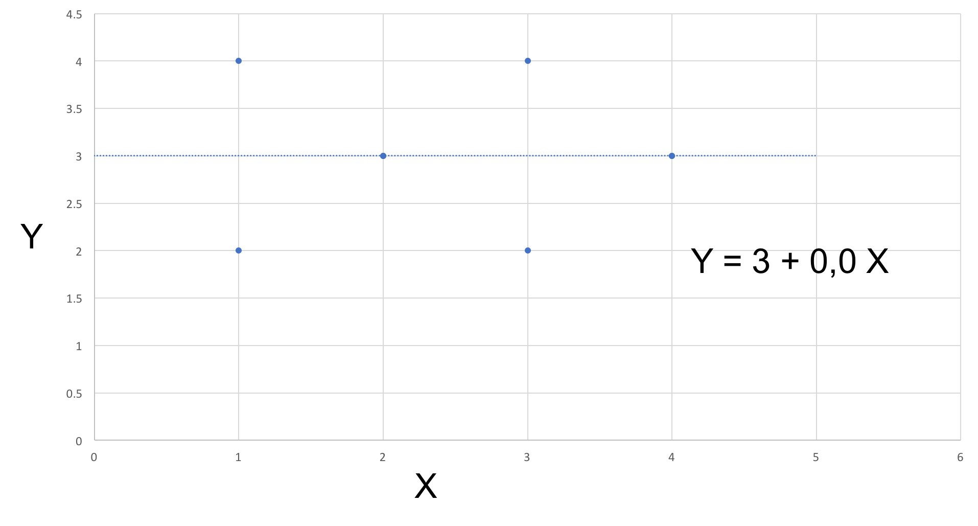
What if …
A lot of ‘inferential statistics’ is based on a simple idea:
“What if the population mean is zero”
Or (in the context of regression)
“What if there is no relationship in the population?”
Notes:
M: Eventueel aanvullen met een plot van een dataset met b1=0

Slide 10
(random)
Sample with n= 8
(random)
Sample with n= 8

Slide 11
Sampling distributions if NO relationship
𝛽₁ = population regression parameter = 0
(𝛽₀ = population intercept = population mean of Y)
Suppose we draw a large number of random samples of 8,
what would we get?
Probability theory.
Central limit theorem.
Notes:
Please note that emphasis is mainly on testing b 1, not on b zero.

Slide 12
Sampling distribution of regression coefficients
Assuming b₁ is zero.
A lot of samples of n (say, n = 8)
Some samples have a positive b₁ and some a negative b₁.
Sampling distribution of b₁'s will be normal!
Negative b₁
b₁ = 0
Positive b₁

Slide 13
Sampling distribution of regression coefficients
On average: b₁’s will be zero
Half the samples will give positive signs, the other half negative ones
If b₁ = 0, a sample showing a ‘very positive’ or a ‘very negative’ sign is unlikely.
b₁ = 0

Slide 14
Hypothesis testing
Suppose we find a b₁ ‘far away from zero’: how big is the chance these data are randomly selected from a population in which the slope is actually zero?
This is the p-value (between 0 and 1).
High p-values: it is very well possible that the data come from a population in which the population slope is actually zero.
Low p-values: it is unlikely that the data we have come from a population in which the population slope is actually zero.
P-value
b₁ = 0

Slide 15
Sampling distribution is normal
What is the SD of the sampling distribution of the population regression coefficient (which is assumed to be zero)?
Three intuitions:
If the sample n is small, the SD is BIG.
If there is a lot of ‘noise’ around the line, the SD is BIG.
If the SD of X in the population is SMALL, the SD is BIG.
𝛽₁ = 0
b₁ = 0,8
Notes:
M: punt 2 begrijp ik echt niet….

Slide 16
Follow up
SD of the sampling distribution of the regression coefficient is ESTIMATED using data from the sample: standard error.
Because the SD it is estimated we do not use the normal distribution, but the (Student’s) t-distribution (which is mainly relevant if n < 30).

Slide 17
https://www.khanacademy.org/math/statistics-probability/significance-tests-one-sample/tests-about-population-mean/v/hypothesis-testing-and-p-values
https://www.khanacademy.org/math/statistics-probability/significance-tests-one-sample/tests-about-population-mean/v/z-statistics-vs-t-statistics

Slide 18
Statistical inference in the context of regression (without formula ☺)

